Slide 1
Student Details
Name:SNEHETHA TATINENI
Email id: snehetha.tatineni774@gmail.com
College : SRK INSTITUTE OF TECHNOLOGY
College State: ANDHRA PRADESH
Internship domain: ARTIFICAL INTELLIGENCE AND MACHINE LEARNING
Internship start date:03-O6-2024
Internship end date: 12-07-2024

Slide 2
PROJECT TITLE/Problem Statement
EMPLOYEES BURNOUT ANALYSIS
USING MACHINE LEARNING

Slide 3
AGENDA
Project Overview
Who will be the end users of the project?
Your solution and its Value Proposition
How did you customize the project and make it your own
Modelling
Results
Links

Slide 4
PROJECT OVERVIEW
The project "Employees Burnout Analysis Using Machine Learning" aims to leverage advanced data analytics to identify and mitigate burnout among employees. By collecting and analyzing data on various factors such as company Type, WFH availability, Designation, Mental Fatigue score,, and employee burn rate, machine learning models can be trained to detect patterns and predict burnout risks. The use of algorithms like decision trees, random forests, and SVM can help in identifying key indicators and providing actionable insights for management to improve workplace conditions and employee well-being.
This project is particularly significant in the current corporate environment where burnout has become a prevalent issue, leading to decreased productivity and high turnover rates. The application of machine learning in this context not only enhances the accuracy of burnout predictions but also enables proactive measures to be taken, thus fostering a healthier and more productive work environment.

Slide 5
WHO ARE THE END USERS of this project?
Human Resources (HR) Departments: HR professionals can use the insights generated by the machine learning models to identify employees at risk of burnout.
Managers and Team Leaders: Managers can utilize the analysis to monitor the workload and stress levels of their team members, enabling them to make informed decisions.
Executives and Organizational Leadership: Senior leaders can leverage the data to understand overall trends in employee health and productivity.
Employees: Employees themselves can benefit indirectly from the project as it leads to a more supportive work culture, reduced stress, and enhanced job satisfaction through the proactive measures taken by the organization based on the analysis.

Slide 6
YOUR SOLUTION AND ITS VALUE PROPOSITION
The solution involves developing and deploying a machine learning system to analyze employee data and identify burnout risk factors. Key components include.
The process begins with data collection from various sources in the form of excel or csv.
Cleaning the data and extracting meaningful features that can indicate burnout, such as excessive overtime, decreased productivity, or frequent absences.
Implementing the models into a user-friendly dashboard or software that HR departments and managers can access. Continuously updating the models with new data to improve accuracy
Cost savings :
Reducing burnout and turnover can lead to significant cost savings for the organization by maintaining a stable
Enhanced Employee well-being: By identifying employees at risk of burnout early, organizations can take proactive steps to provide support, improve work conditions, and reduce stress, leading to happier and healthier employees.

Slide 7
How did you customize the project and make it your own
Unique Data Sources and Features
Customized Data collection by feedback mechanisms, internal communication patterns to enrich the dataset.
Specific Feature Engineering – Identifying incorporate unique burnout indicators relevant to organization.
Customized machine learning models - Customize model parameters and tuning processes to enhance prediction accuracy specific to your company's data.
Exploratory Data analysis, Customization predictions.
Developing scenario-specific predictive models that can provide insights into different types of burnout
Employee Involvement and feedback
Scenario-specific predictive analytics

Slide 8
MODELLING
The step by step process of model building
Data Handling and Pre-processing
Data analysis
Exploratory Data analysis
Training and Splitting
Model Applying
Hyperparameter Tuning
Model reclassification
Comparing best results of regression and classification models.

Slide 9
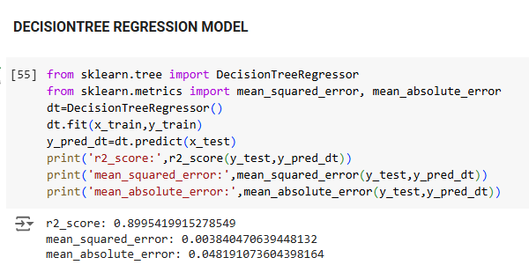
Results

Slide 10
LINKS
https://github.com/Snehetha-7704/Employee_Burnout_Prediction

